Slide 1
Crave Casinos and Resorts
Dashboard prototypes and viz
Kaushik Bandaru
1945699

Slide 2
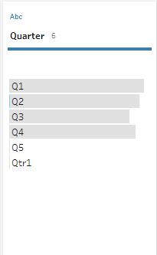
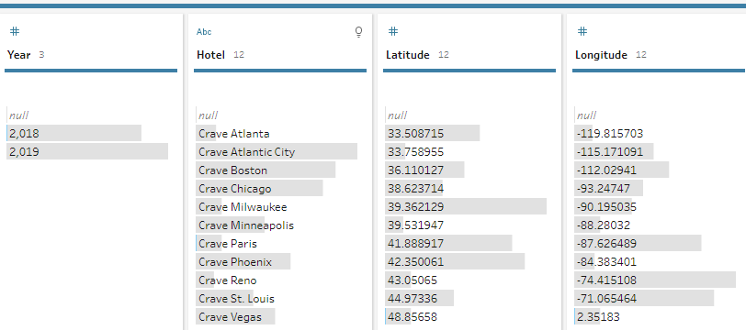
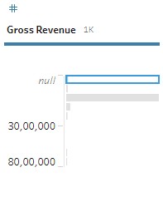
Errors in dataset
Notes:
I used tableau prep builder to check for errors in dataset. There were 0 mismatching fields. So, all values fit into datatype. There are very few null values as shown in the above screenshot. It was only one instance of null value so I have excluded it. There is a row with q5 as quarter . I excluded rows with null values because they are very few in number.

Slide 3
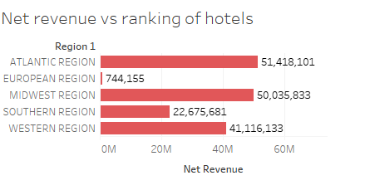
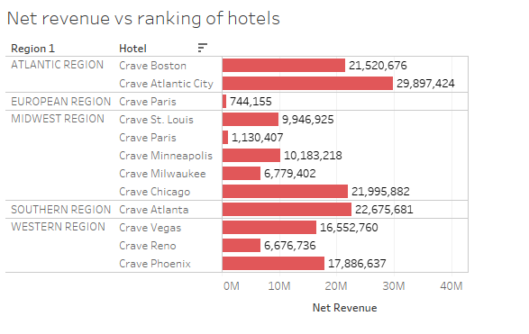
Net revenue in each region with drill down option to rank hotels
Notes:
The graph on top shows net revenue for every region with an option to drill down. When we use drill down option , it shows the ranking of different hotels in that region based on net revenue. You can see that I used drill down option as region1 has a + sign. This slide satisfies the requirement of the CEO who requested for the option to select a region and see ranking of properties by net revenue. I have used a bar chart here because we are comparing hotels and it is very easy to make out the difference in a bar chart. I have used pink here as it is easy to recognize.

Slide 4
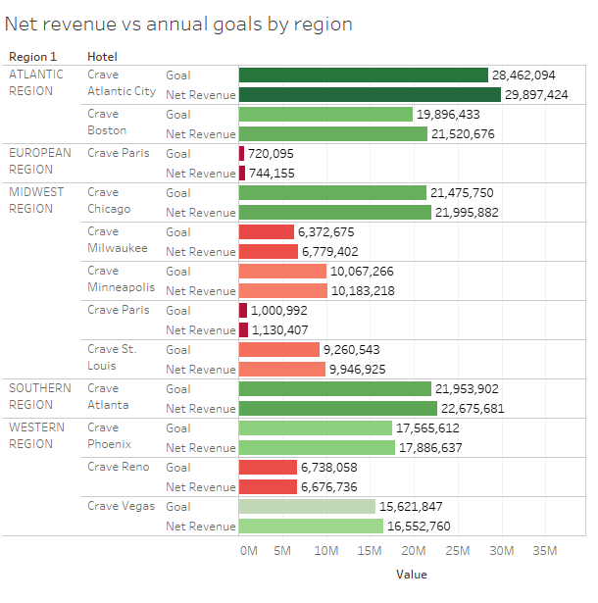
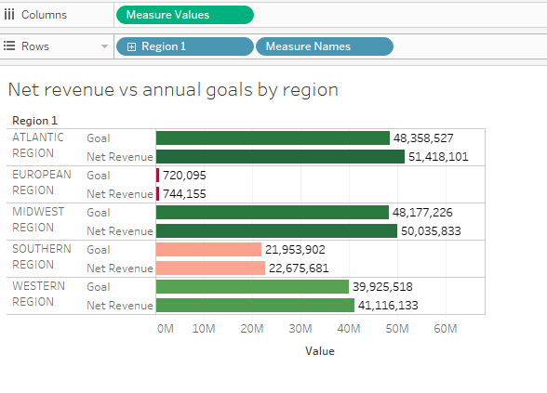

Drill down option to check if every hotel is reaching its goals
Notes:
I used drill option here again so that we can see if different regions in a region are matching their goal or not. Net revenue vs annual goals by region has been requested by the board. I have added drill down option even though they didn’t ask for it. I have included legend here so that we can tell which hotels are performing well and which hotels are not based on color. I created a hierarchy for regions and hotels as every region comprises of unique hotels.

Slide 5
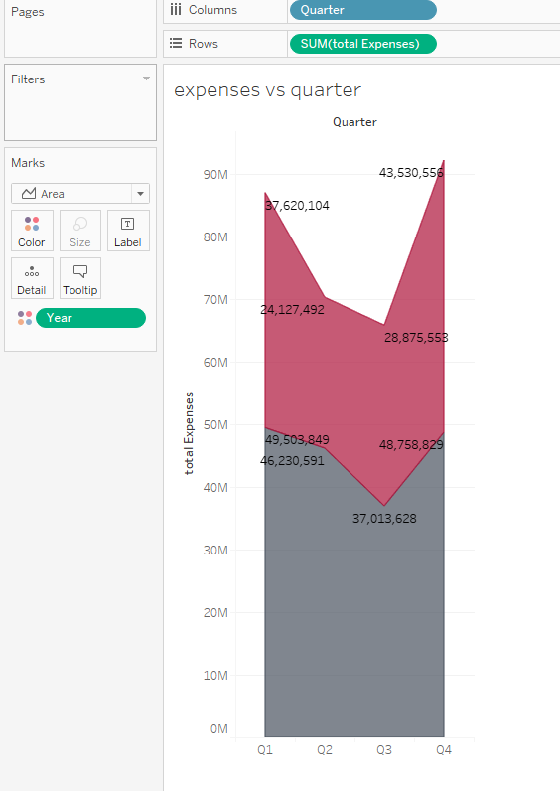

Total expenses vs quarter
Notes:
I created a calculated field called total expenses where I added cost of goods and wages to expenses. This graph is for CFO . It shows how total expenses changed by quarter in 2018 and 2019. I have used area chart here because it shows the trends very clearly. We can see that expenses went down from Q1 to Q2 and further decreased in Q3 but went up in Q4. We can see it’s trend in both the years which is almost the same trend.

Slide 6
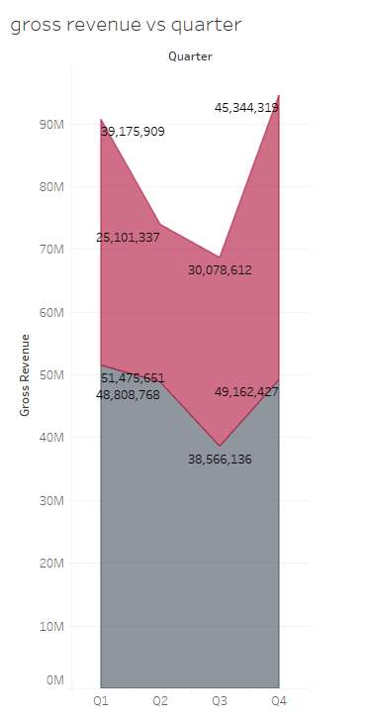
Gross revenue vs quarter
Notes:
This graph is for CFO . It shows how gross revenue changed by quarter in 2018 and 2019. I have used area chart here because it shows the trends very clearly. We can see that Gross Revenue went down from Q1 to Q2 and further decreased in Q3 but went up in Q4. We can see it’s trend in both the years which is almost the same trend.

Slide 7
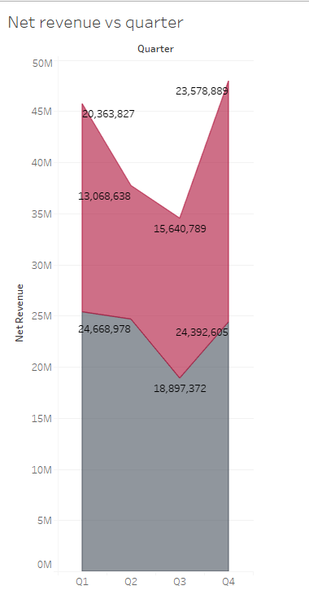
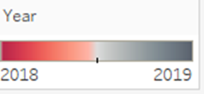
Net revenue vs quarter
Notes:
This graph is for CFO . It shows how Net revenue changed by quarter in 2018 and 2019. I have used area chart here because it shows the trends very clearly. We can see that Net Revenue went down from Q1 to Q2 and further decreased in Q3 but went up in Q4. We can see it’s trend in both the years which is almost the same trend.

Slide 8
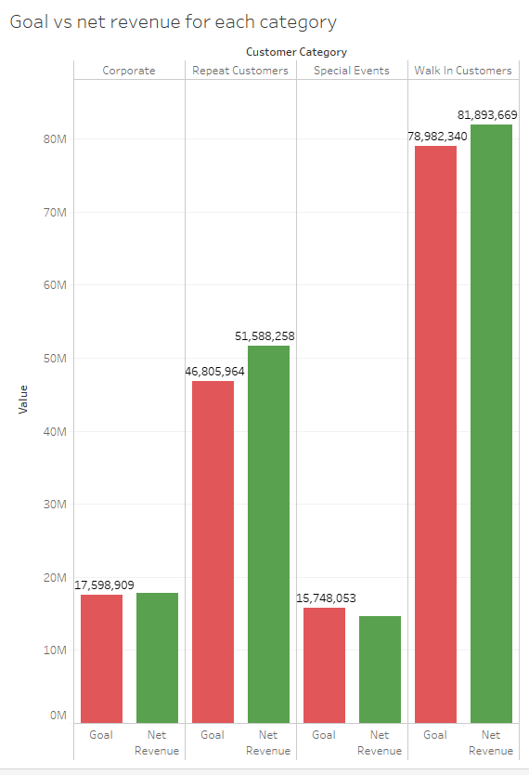
Goals vs net revenue for each customer category
Notes:
This graph shows if net revenue is meeting the goals in different customer categories. We can see that special events is where goal was not met. I have used side by side bars here as it is very easy to compare and tell if the goals are met or not.

Slide 9
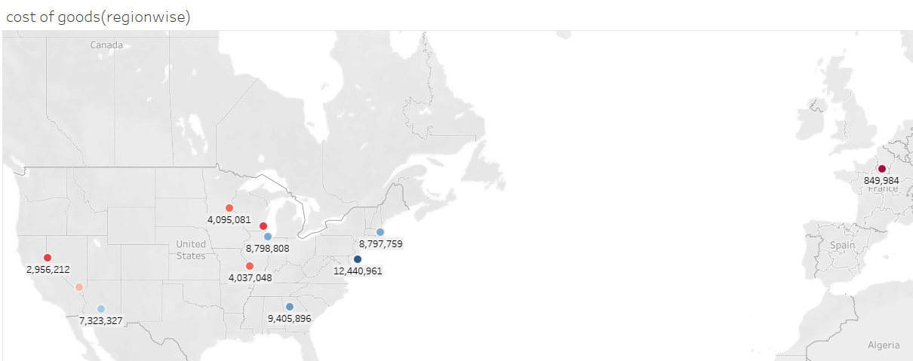

Cost of goods region wise(Map)
Notes:
This map shows cost of goods region wise. This graph is for the COO. Cost of goods is lowest in Paris and highest in NYC.

Slide 10
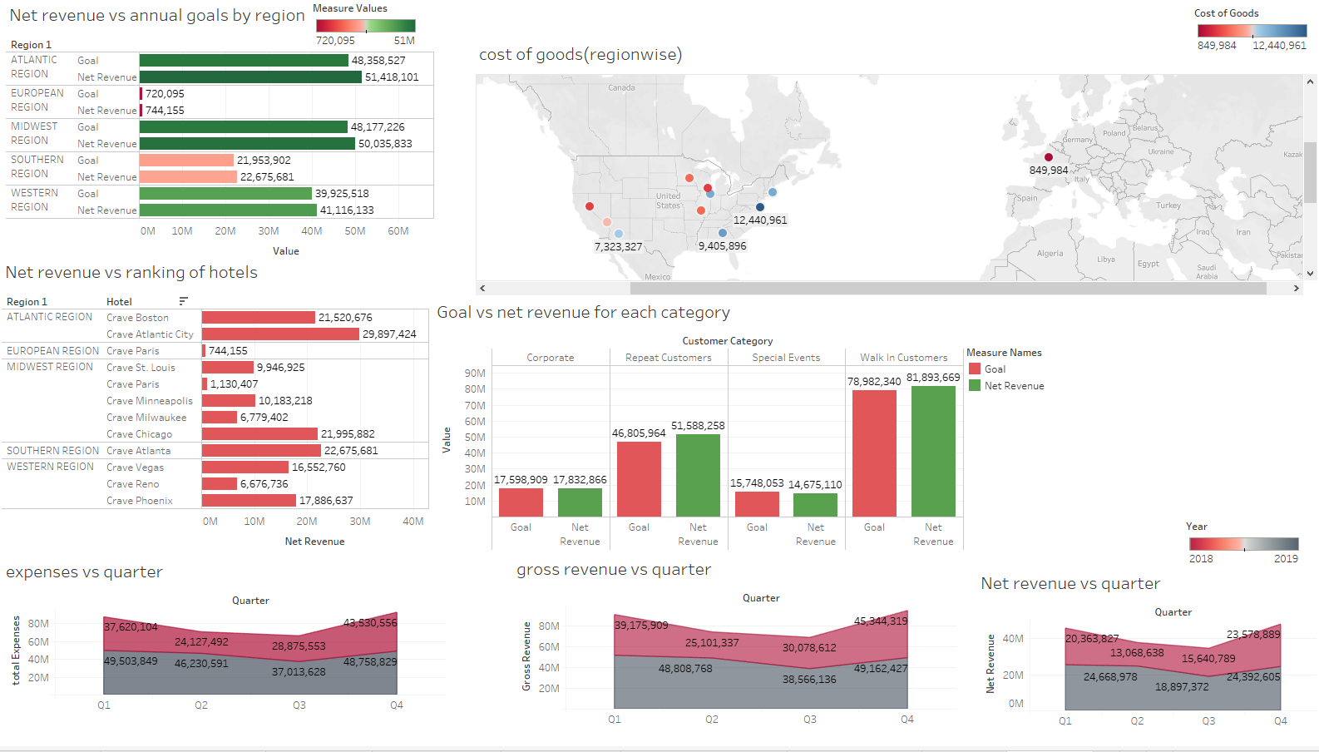
Dashboard prototype
Notes:
This dashboard shows all the important graphs required by the management. I have explained each viz in a separate slide. I have mostly used pink and green in all the charts to maintain uniformity on the dashboard.

Slide 11
Inference from graphs
We can infer that crave casinos is meeting the overall revenue goals in all aspects and performing pretty well.
Crave Paris is among the least performing hotels in all regions
Atlantic region has the highest net revenue even though it has only 2 hotels. So it is the best performing region.
Quarter 1 and Quarter 4 have higher (net and gross) revenue and high expenses compared to quarter 2 and quarter 3 in both the years and across all regions.
Net revenue couldn’t meet it’s goal only in the special events customer category.
Paris has the lowest cost of goods and New York has the highest.

Slide 12
Assumptions
I have removed the 0 values in the dataset as it did not add any value to the dashboard
I assume that a lot of people will have access and will use this dashboard and authorization will be given accordingly.
Assuming that the use of slicers should be made to view data differently.
Assuming that the person who will be use this dashboard will be undergoing a training and will be having proper knowledge about evaluating the graphs.
Assuming the currency for all expenses and revenues is in USD

Slide 13
Risks
Users who do not have authorization will not be able to access the dashboard.
If the user does not undergo the training he/she wont be able to understand the dashboard.
Some of the data was eliminated as it had null values and errors. It should not affect the visualizations in the dashboard

